Slide 1
MICROSOFT MOVIE STUDIO

Slide 2
Summary
The project entails a comprehensive analysis of market trends, audience preferences, and cultural dynamics to strategically determine the ideal types of films to produce. Through meticulous research and data-driven insights, the project aims to identify and understand the target demographic, their evolving entertainment needs, and the prevailing themes and genres that resonate with them. By incorporating elements of predictive analytics and trend forecasting, the project seeks to enable Microsoft Studio to make informed decisions about the creation of compelling, innovative, and culturally relevant films that have the potential to captivate and engage audiences worldwide. Additionally, by considering the broader social and cultural landscape, the project will assist Microsoft in the development of a coherent and diverse film portfolio that reflects the values, aspirations, and diverse experiences of contemporary society.

Slide 3
Outline
Business Problem
Data
Methods
Results
Conclusions

Slide 4
Business Problem
Microsoft sees all the big companies creating original video content and they want to get in on the fun. They have decided to create a new movie studio, but they don’t know anything about creating movies. The aim of this project is to explore what types of films are currently doing the best at the box office. The findings will be translated into actionable insights that the head of Microsoft's new movie studio can use to help decide what type of films to create.

Slide 5
Data
The project involves a comprehensive examination of various key metrics, including audience ratings, box office performance, audience reviews, domestic and foreign market trends, audience preferences, viewing patterns, and emerging thematic interests. By studying the performance of comparable films in the market, Microsoft Studio can make data-driven decisions about budget allocation, production strategies, and marketing campaigns, ultimately optimizing the chances of creating commercially successful and critically acclaimed films that resonate with the intended audience. The following data was used:
-Box Office Mojo
-MDB
-Rotten Tomatoes
-TheMovieDB.org

Slide 6
Methods
The collected data was explored to identify trends and patterns in successful movie genres, trends, and audience preferences. Visualisations were also used to uncover meaningful insights and make informed decisions in order to advise our client Microsoft accordingly.

Slide 7
Results
The results indicate that the most preferred movie genre is drama followed by documentary, comedy, thriller and horror in that order. Therefore, the client, Microsoft, can be advised to leverage this information to target popular genres and explore opportunities for diversification to cater to a wider audience

Slide 8
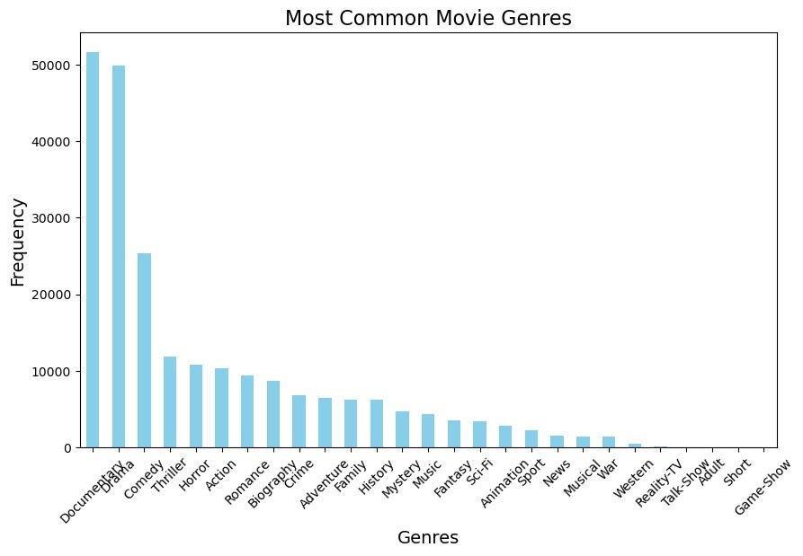

Slide 9
Results…
The projection results on trends in movie production shows a declining trend. The results help to forecast based on the fluctuating trend of movie production. This could be an indicator that the business is no longer lucrative and the producers could be moving away from this business. It is important to understand the reasons behind these fluctuations such as industry trends. This can help Microsoft make informed decisions about production timelines and release schedules.

Slide 10
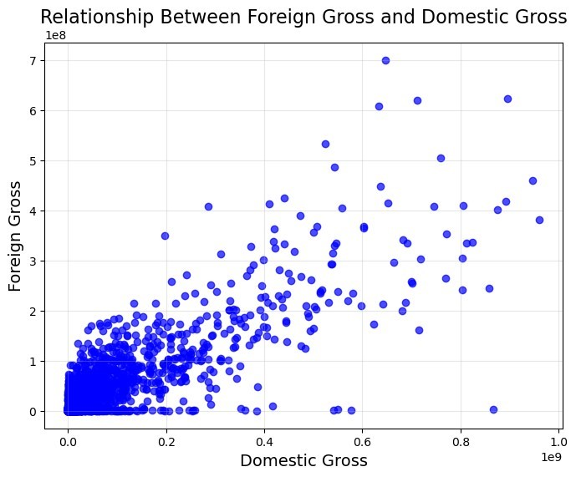

Slide 11
Results…
The results indicate that there is no relationship between runtime and domestic gross, meaning that Microsoft should not consider the length of a movie as a factor that might influence their sales.

Slide 12
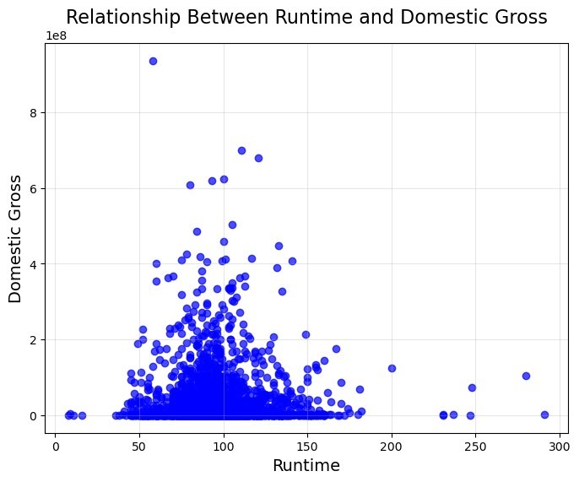

Slide 13
Results…
The results indicate a positive correlation between domestic and foreign gross, in that, when one increases the other increases as well. This means that the locality does not affect movies sales, whether domestic or international. For Microsoft, this means that when producing a movie that sells locally, it will also sell internationally so they can use domestic preferences to know the type of movie to produce.

Slide 14
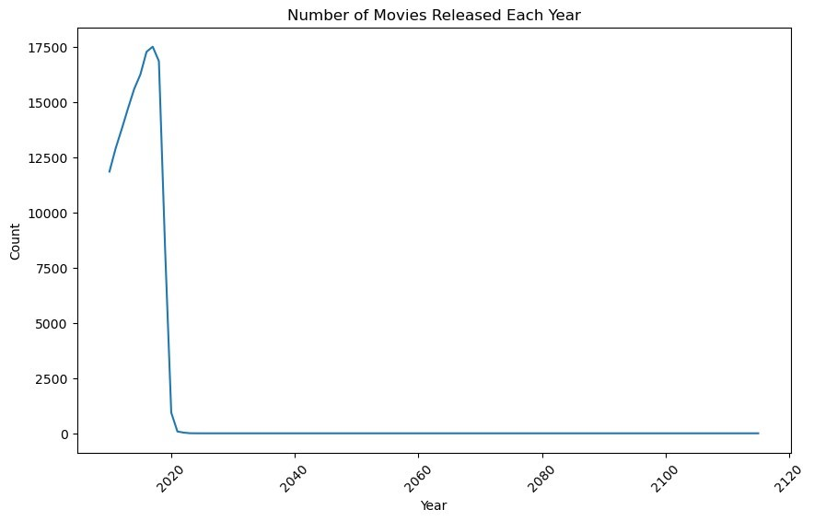

Slide 15
Results…
From the results, the average ratings has remained constant over the years while the number of votes has taken a downward trend. This could be an indicator that people are no longer interested in watching movies. If Microsoft should venture into this business thhen they should up their game and produce high quality content to sustain audience interest and engagement. Moreover, the declining number of votes for movies may be an indicator of a potential shift in audience engagement patterns. This should be considered by Microsoft when planning marketing and promotional strategies.

Slide 16
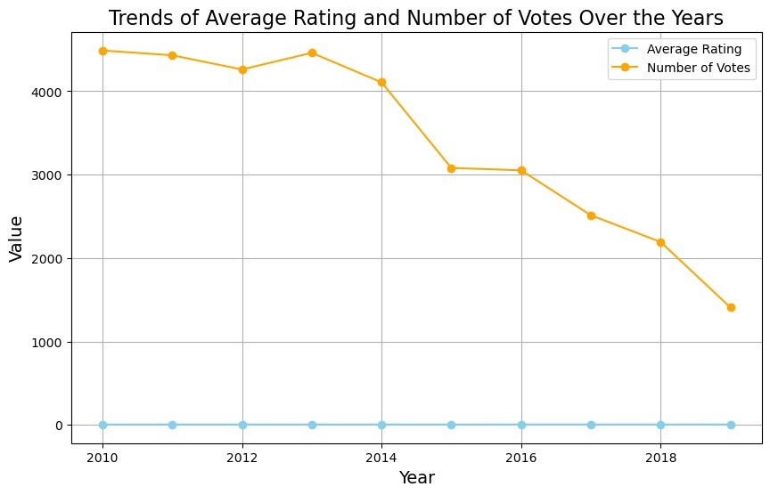

Slide 17
Conclusions
In conclusion, based on the analysis of the movie industry data, it is evident that certain factors play a crucial role in determining the success of movies at the box office. The exploration of the this data revealed valuable insights that can guide Microsoft in establishing its new movie studio and understanding the dynamics of the industry.With these insights, Microsoft can strategically plan its entry into the movie industry, focusing on producing high-quality content within popular genres while prioritizing audience preferences.

Slide 18
Thank You!
Email: jebiwottalice20@gmail.com
GitHub: @aliciachebby
LinkedIn: linkedin.com/in/alicejebiwott/

